Slide 1
INST 346 Spring 2025
Lectures 13 and 14
March 10 and 12, 2025
Professor Keith Marzullo

Slide 2
Application layer: Learning objectives
A broad look, introducing key concepts and terminology
Principles of network applications
Web and HTTP
The Domain Name Systems
Video streaming and content distribution networks

Slide 3
Principles of network applications

Slide 4
Some network apps
social networking
Web
text messaging
e-mail
multi-user network games
streaming stored video (YouTube, Hulu, Netflix)
P2P file sharing
voice over IP (e.g., Skype)
real-time video conferencing (e.g., Zoom)
Internet search
remote login
…

Slide 5
















Creating a network app
application
transport
network
data link
physical
write programs that:
run on (different) end systems
communicate over network
e.g., web server software communicates with browser software
no need to write software for network-core devices
network-core devices do not run user applications
applications on end systems allows for rapid app development, propagation
mobile network
national or global ISP
local or regional ISP
home network
content
provider
network
application
transport
network
data link
physical
application
transport
network
data link
physical
datacenter
network
enterprise
network

Slide 6
Client-server paradigm
server:
always-on host
permanent IP address
often in data centers, for scaling
clients:
contact, communicate with server
may be intermittently connected
may have dynamic IP addresses
do not communicate directly with each other
examples: HTTP, IMAP, FTP
mobile network
national or global ISP
local or regional ISP
home network
content
provider
network
datacenter
network
enterprise
network

Slide 7
Peer-peer architecture
no always-on server
arbitrary end systems directly communicate
peers request service from other peers, provide service in return to other peers
self scalability – new peers bring new service capacity, as well as new service demands
peers are intermittently connected and change IP addresses
complex management
example: P2P file sharing [BitTorrent]
Our standard Internet architecture showing peer-to-peer architecture
mobile network
national or global ISP
local or regional ISP
home network
content
provider
network
datacenter
network
enterprise
network

Slide 8
Processes communicating
process: program running within a host
within same host, two processes communicate using inter-process communication (defined by OS)
processes in different hosts communicate by exchanging messages
clients, servers
client process: process that initiates communication
server process: process that waits to be contacted
note: applications with P2P architectures have client processes & server processes

Slide 9

Sockets
process sends/receives messages to/from its socket
socket analogous to door
sending process shoves message out door
sending process relies on transport infrastructure on other side of door to deliver message to socket at receiving process
two sockets involved: one on each side
application
socket
application
controlled by
app developer
process
process
transport
transport
network
network
controlled
by OS
link
Internet
link
physical
physical

Slide 10
Addressing processes
to receive messages, process must have identifier
host device has unique 32-bit IP address
Q: does IP address of host on which process runs suffice for identifying the process?
A: no, many processes can be running on same host
identifier includes both IP address and port numbers associated with process on host.
example port numbers:
HTTP server: 80
mail server: 25
to send HTTP message to gaia.cs.umass.edu web server:
IP address: 128.119.245.12
port number: 80
more shortly…

Slide 11
An application-layer protocol defines:
types of messages exchanged,
e.g., request, response
message syntax:
what fields in messages & how fields are delineated
message semantics
meaning of information in fields
rules for when and how processes send & respond to messages
open protocols:
defined in RFCs, everyone has access to protocol definition
allows for interoperability
e.g., HTTP, SMTP
proprietary protocols:
e.g., Skype, Zoom

Slide 12
What transport service does an app need?
data integrity
some apps (e.g., file transfer, web transactions) require 100% reliable data transfer
other apps (e.g., audio) can tolerate some loss
throughput
some apps (e.g., multimedia) require minimum amount of throughput to be “effective”
other apps (“elastic apps”) make use of whatever throughput they get
timing
some apps (e.g., Internet telephony, interactive games) require low delay to be “effective”
security
encryption, data integrity, …

Slide 13
Transport service requirements: common apps
application | data loss | throughput | time sensitive?
file transfer/download | no loss | elastic | no
email | no loss | elastic | no
Web documents | no loss | elastic | no
real-time audio/video | loss tolerant | audio: 5Kbps-1Mbps video:10Kbps-5Mbps | tens of milliseconds
streaming audio/video | loss tolerant | audio: 5Kbps-1Mbps video:10Kbps-5Mbps | a few seconds
interactive games | loss tolerant | Kbps+ | tens of milliseconds
text messaging | no loss | elastic | sort of

Slide 14
Internet transport protocols services
TCP service:
reliable transport between sending and receiving process
flow control: sender won’t overwhelm receiver
congestion control: throttle sender when network overloaded
connection-oriented: setup required between client and server processes
does not provide: timing, minimum throughput guarantee, security
UDP service:
unreliable data transfer between sending and receiving process
does not provide reliability, flow control, congestion control, timing, throughput guarantee, security, or connection setup.
Q: why bother? Why is there a UDP?

Slide 15
Securing TCP
Vanilla TCP & UDP sockets:
no encryption
cleartext passwords sent into socket traverse Internet in cleartext (!)
Transport Layer Security (TLS)
provides encrypted TCP connections
data integrity
end-point authentication
TLS implemented in application layer
apps use TLS libraries, that use TCP in turn
cleartext sent into “socket” traverse Internet encrypted
more: Chapter 8

Slide 16
HTTP: Hypertext Transfer Protocol

Slide 17
Web and HTTP: Review of basic idea
web page consists of objects, each of which can be stored on different Web servers
object can be HTML file, JPEG image, Java applet, audio file,…
web page consists of base HTML-file which includes several referenced objects, each addressable by a URL, e.g.,
www.someschool.edu/someDept/pic.gif
host name
path name

Slide 18

HTTP overview
HTTP: hypertext transfer protocol
Web’s application-layer protocol
client/server model:
client: browser that requests, receives, (using HTTP protocol) and “displays” Web objects
server: Web server sends (using HTTP protocol) objects in response to requests
HTTP request
PC running
Firefox browser
HTTP response
HTTP request
server running
Apache Web
server
HTTP response
iPhone running
Safari browser

Slide 19
HTTP overview (continued)
HTTP uses TCP:
client initiates TCP connection (creates socket) to server, port 80
server accepts TCP connection from client
HTTP messages (application-layer protocol messages) exchanged between browser (HTTP client) and Web server (HTTP server)
TCP connection closed
HTTP is “stateless”
server maintains no information about past client requests
Protocols that maintain “state” are complex!
past history must be maintained
if the client or server crash, their view of the state may be inconsistent and need to be reconciled

Slide 20
HTTP connections: two types
HTTP/1.0 Non-persistent
TCP connection opened
at most one object sent over TCP connection
TCP connection closed
downloading multiple objects required multiple connections
RFC 1945 (May 1996)
HTTP/1.1 Persistent
TCP connection opened to a server
multiple objects can be sent over single TCP connection between client, and that server
TCP connection closed
RFC 2068 (January 1997)

Slide 21
Non-persistent HTTP: example
User enters URL:
www.someSchool.edu/someDepartment/home.index
(containing text, references to 10 jpeg images)
1a. HTTP client initiates TCP connection to HTTP server (process) at www.someSchool.edu on port 80
1b. HTTP server at host www.someSchool.edu waiting for TCP connection at port 80 “accepts” connection, notifying client
2. HTTP client sends HTTP request message (containing URL) into TCP connection socket. Message indicates that client wants object someDepartment/home.index
3. HTTP server receives request message, forms response message containing requested object, and sends message into its socket
time

Slide 22
Non-persistent HTTP: example (cont.)
User enters URL:
www.someSchool.edu/someDepartment/home.index
(containing text, references to 10 jpeg images)
4. HTTP server closes TCP connection.
5. HTTP client receives response message containing html file, displays html. Parsing html file, finds 10 referenced jpeg objects
6. Steps 1-5 repeated for each of 10 jpeg objects
time

Slide 23
Persistent HTTP
Non-persistent HTTP issues:
requires 2 RTTs per object
OS overhead for each TCP connection
browsers often open multiple parallel TCP connections to fetch referenced objects in parallel
Persistent HTTP (HTTP1.1):
server leaves connection open after sending response
subsequent HTTP messages between same client/server sent over open connection
client sends requests as soon as it encounters a referenced object
as little as one RTT for all the referenced objects (cutting response time in half)

Slide 24
HTTP request message
two types of HTTP messages: request, response
HTTP request message:
ASCII (human-readable format)
carriage return character
request line (GET, POST,
HEAD commands)
line-feed character
GET /index.html HTTP/1.1\r\n
Host: www-net.cs.umass.edu\r\n
User-Agent: Mozilla/5.0 (Macintosh; Intel Mac OS X 10.15; rv:80.0) Gecko/20100101 Firefox/80.0 \r\n
Accept: text/html,application/xhtml+xml\r\n
Accept-Language: en-us,en;q=0.5\r\n
Accept-Encoding: gzip,deflate\r\n
Connection: keep-alive\r\n
\r\n
header
lines
carriage return, line feed at start of line indicates end of header lines

Slide 25
HTTP request message: general format
method
sp
URL
sp
version
cr
lf
request
line
header field name
value
cr
lf
~
~
header
lines
~
~
header field name
value
cr
lf
cr
lf
~
entity body
~
body
~
~

Slide 26
Other HTTP request messages
POST method:
web page often includes form input
user input sent from client to server in entity body of HTTP POST request message
HEAD method:
requests headers (only) that would be returned if specified URL were requested with an HTTP GET method.
PUT method:
uploads new file (object) to server
completely replaces file that exists at specified URL with content in entity body of POST HTTP request message
GET method (for sending data to server):
include user data in URL field of HTTP GET request message (following a ‘?’):
www.somesite.com/animalsearch?monkeys&banana

Slide 27
HTTP response message
status line (protocol
status code status phrase)
HTTP/1.1 200 OK
Date: Tue, 08 Sep 2020 00:53:20 GMT
Server: Apache/2.4.6 (CentOS) OpenSSL/1.0.2k-fips PHP/7.4.9 mod_perl/2.0.11 Perl/v5.16.3
Last-Modified: Tue, 01 Mar 2016 18:57:50 GMT
ETag: "a5b-52d015789ee9e"
Accept-Ranges: bytes
Content-Length: 2651
Content-Type: text/html; charset=UTF-8
\r\n
data data data data data ...
header
lines
data, e.g., requested
HTML file

Slide 28
HTTP response status codes
status code appears in 1st line in server-to-client response message.
some sample codes:
200 OK
request succeeded, requested object later in this message
301 Moved Permanently
requested object moved, new location specified later in this message (in Location: field)
400 Bad Request
request msg not understood by server
404 Not Found
requested document not found on this server
505 HTTP Version Not Supported

Slide 29

Maintaining user/server state: cookies
Recall that HTTP GET/response interaction is stateless
no notion of multi-step exchanges of HTTP messages to complete a Web “transaction”
no need for client/server to track “state” of multi-step exchange
all HTTP requests are independent of each other
no need for client/server to “recover” from a partially-completed-but-never-completely-completed transaction
a stateful protocol: client makes two changes to X, or none at all
X
lock data record X
X
OK
update X X’
X’
OK
t’
update X X’’
OK
X’’
unlock X
OK
X’’
time
time
Q: what happens if network connection or client crashes at t’ ?
Notes:
t’

Slide 30
Maintaining user/server state: cookies
client
Amazon server
ebay 8734
usual HTTP request msg
Amazon server
creates ID
1678 for user
cookie file
usual HTTP response
set-cookie: 1678
backend
database
create
entry
ebay 8734
amazon 1678
usual HTTP request msg
cookie: 1678
cookie-
specific
action
access
usual HTTP response msg
one week later:
access
ebay 8734
amazon 1678
usual HTTP request msg
cookie: 1678
cookie-
specific
action
usual HTTP response msg
time
time
Notes:
t’

Slide 31
HTTP cookies: comments
aside
What cookies can be used for:
authorization
shopping carts
recommendations
user session state (Web e-mail)
cookies and privacy:
cookies permit sites to learn a lot about you on their site.
third party persistent cookies (tracking cookies) allow common identity (cookie value) to be tracked across multiple web sites
Challenge: How to keep state?
at protocol endpoints: maintain state at sender/receiver over multiple transactions
in messages: cookies in HTTP messages carry state
RFC 2109 (February 1997)
RFC 2965 (October 2000)
RFC 6265 (April 2011)
Notes:
t’

Slide 32

Web caches (1)
Goal: satisfy client requests without involving origin server
user configures browser to point to a (local) Web cache
browser sends all HTTP requests to cache
if object in cache: cache returns object to client
else cache requests object from origin server, caches received object, then returns object to client
Web
cache
HTTP request
HTTP request
client
origin
server
client
Notes:
t’

Slide 33
Web caches (2)
Goal: satisfy client requests without involving origin server
user configures browser to point to a (local) Web cache
browser sends all HTTP requests to cache
if object in cache: cache returns object to client
else cache requests object from origin server, caches received object, then returns object to client
Web
cache
client
HTTP response
HTTP response
origin
server
client
Notes:
t’

Slide 34
Web caches (3)
Goal: satisfy client requests without involving origin server
user configures browser to point to a (local) Web cache
browser sends all HTTP requests to cache
if object in cache: cache returns object to client
else cache requests object from origin server, caches received object, then returns object to client
Web
cache
client
origin
server
HTTP request
HTTP response
client
Notes:
t’

Slide 35


Web caches (aka proxy servers)
Web cache acts as both client and server
server for original requesting client
client to origin server
Why Web caching?
reduce response time for client request
cache is closer to client
reduce traffic on an institution’s access link
Internet is dense with caches
enables “poor” content providers to more effectively deliver content
server tells cache about object’s allowable caching in response header:
Notes:
re: poor content providers – like in real-estate, location is everything. servers want to be close to clients.

Slide 36
HTTP/2 and HTTP/3
HTTP/2 RFC 9113 (June 2022)
Developed by IETF HTTP Working Group (“httpbis”)
Data compression of HTTP headers
Pushing unrequested objects to clients
Prioritization of requests
Multiplexing multiple requests over a single TCP connection
HTTP/3 RFC 9114 (June 2022)
Developed by IETF HTTP and QUIC Working Groups
Built over QUIC Transport Protocol (RFC 9000, May 2021)
Adds security, per object error- and congestion-control (more pipelining) over UDP

Slide 37
HTTP/2: mitigating Head of Line (HOL) blocking
HTTP 1.1: client requests 1 large object (e.g., video file) and 3 smaller objects
server
GET O₄
GET O₃
GET O₂
GET O₁
object data requested
client
O₁
O₂
O₁
O₃
O₂
O₃
O₄
O₄
objects delivered in order requested: O₂, O₃, O₄ wait behind O₁
Notes:
t’

Slide 38
HTTP/2: mitigating HOL blocking
HTTP/2: objects divided into frames: frame transmission interleaved
server
GET O₄
GET O₃
GET O₂
GET O₁
object data requested
client
O₂
O₄
O₃
O₁
O₂
O₃
O₄
O₁
O₂, O₃, O₄ delivered quickly, O₁ slightly delayed
Notes:
shortest job first: decreased average delay!

Slide 39
DNS: Domain Name System

Slide 40
DNS: Domain Name System
people: many identifiers:
SSN, name, passport #
Internet hosts, routers:
IP address (32 bit) - used for addressing datagrams
“name”, e.g., cs.umass.edu - used by humans
Q: how to map between IP address and name, and vice versa ?
Domain Name System (DNS):
distributed database implemented in hierarchy of many name servers
application-layer protocol: hosts, DNS servers communicate to resolve names (address/name translation)
note: core Internet function, implemented as application-layer protocol
complexity at network’s “edge”

Slide 41
DNS: services, structure
DNS services:
hostname-to-IP-address translation
host aliasing
canonical, alias names
mail server aliasing
load distribution
replicated Web servers: many IP addresses correspond to one name
Q: Why not centralize DNS?
single point of failure
traffic volume
distant centralized database
maintenance
A: doesn‘t scale!
Comcast DNS servers alone: 600B DNS queries/day

Slide 42
DNS: a distributed, hierarchical database
Root DNS Servers
Root
…
…
.com DNS servers
.org DNS servers
.edu DNS servers
Top Level Domain
…
…
…
…
yahoo.com
DNS servers
amazon.com
DNS servers
pbs.org
DNS servers
nyu.edu
DNS servers
umass.edu
DNS servers
Authoritative
Client wants IP address for www.amazon.com; 1st approximation:
client queries root server to find .com DNS server
client queries .com DNS server to get amazon.com DNS server
client queries amazon.com DNS server to get IP address for www.amazon.com

Slide 43
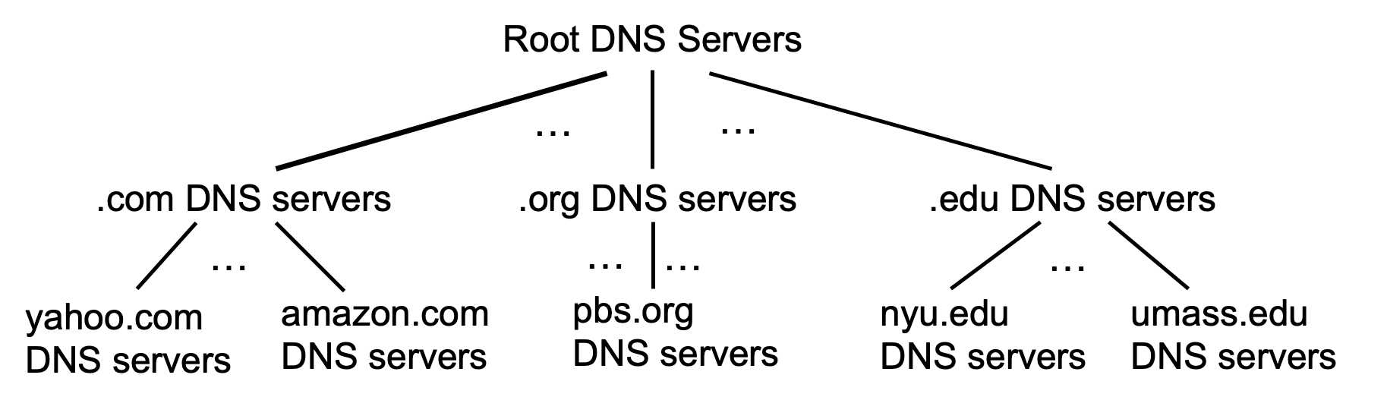
DNS: root name servers
official, contact-of-last-resort by name servers that can not resolve name

Slide 44
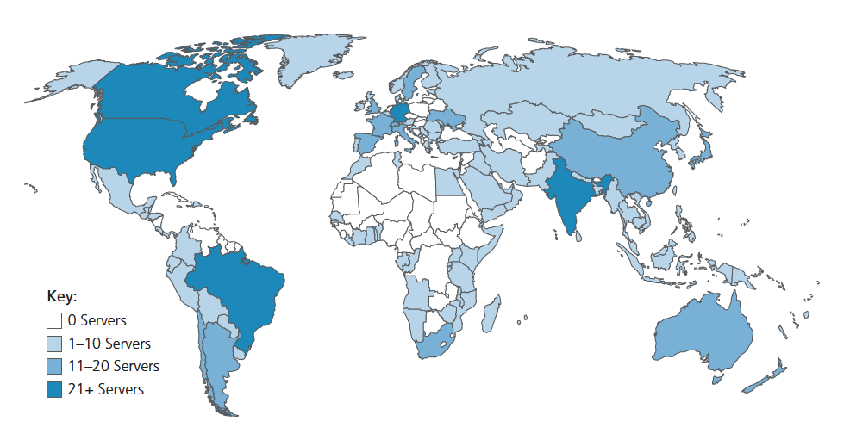
DNS: root name servers
official, contact-of-last-resort by name servers that can not resolve name
incredibly important Internet function
Internet couldn’t function without it!
DNSSEC – provides security (authentication, message integrity)
ICANN (Internet Corporation for Assigned Names and Numbers) manages root DNS domain
13 logical root name “servers” worldwide each “server” replicated many times (~200 servers in US)

Slide 45
Top-Level Domain, and authoritative servers
Top-Level Domain (TLD) servers:
responsible for .com, .org, .net, .edu, .aero, .jobs, .museums, and all top-level country domains, e.g.: .cn, .uk, .fr, .ca, .jp
Network Solutions: authoritative registry for .com, .net TLD
Educause: .edu TLD
authoritative DNS servers:
organization’s own DNS server(s), providing authoritative hostname to IP mappings for organization’s named hosts
can be maintained by organization or service provider

Slide 46
Local DNS name servers
when host makes DNS query, it is sent to its local DNS server
Local DNS server returns reply, answering:
from its local cache of recent name-to-address translation pairs (possibly out of date!)
forwarding request into DNS hierarchy for resolution
each ISP has local DNS name server; to find yours:
MacOS: % scutil --dns
Windows: >ipconfig /all
local DNS server doesn’t strictly belong to hierarchy

Slide 47
DNS name resolution: iterated query
root DNS server
Example: host at engineering.nyu.edu wants IP address for gaia.cs.umass.edu
2
3
TLD DNS server
Iterated query:
contacted server replies with name of server to contact
“I don’t know this name, but ask this server”
1
4
8
5
requesting host at
engineering.nyu.edu
local DNS server
dns.nyu.edu
gaia.cs.umass.edu
7
6
authoritative DNS server
dns.cs.umass.edu

Slide 48
DNS name resolution: recursive query
root DNS server
Example: host at engineering.nyu.edu wants IP address for gaia.cs.umass.edu
2
3
7
6
Recursive query:
puts burden of name resolution on contacted name server
heavy load at upper levels of hierarchy?
1
TLD DNS server
8
requesting host at
engineering.nyu.edu
local DNS server
dns.nyu.edu
5
4
gaia.cs.umass.edu
authoritative DNS server
dns.cs.umass.edu

Slide 49
Caching DNS Information
once (any) name server learns mapping, it caches mapping, and immediately returns a cached mapping in response to a query
caching improves response time
cache entries timeout (disappear) after some time (TTL)
TLD servers typically cached in local name servers
cached entries may be out-of-date
if named host changes IP address, may not be known Internet-wide until all TTLs expire!
best-effort name-to-address translation!

Slide 50
DNS records
DNS: distributed database storing resource records (RR)
RR format: (name, value, type, ttl)
type=A
name is hostname
value is IP address
type=CNAME
name is alias name for some “canonical” (the real) name
www.ibm.com is really servereast.backup2.ibm.com
value is canonical name
type=NS
name is domain (e.g., foo.com)
value is hostname of authoritative name server for this domain
type=MX
value is name of SMTP mail server associated with name

Slide 51
Inserting records into DNS
example: new startup “Network Utopia”
register name networkuptopia.com at DNS registrar (e.g., Network Solutions)
provide names, IP addresses of authoritative name server (primary and secondary)
registrar inserts NS, A RRs into .com TLD server:
(networkutopia.com, dns1.networkutopia.com, NS)
(dns1.networkutopia.com, 212.212.212.1, A)
create authoritative server locally with IP address 212.212.212.1
type A record for www.networkuptopia.com
type MX record for networkutopia.com

Slide 52
DNS security
DDoS attacks
bombard root servers with traffic
not successful to date
traffic filtering
local DNS servers cache IPs of TLD servers, allowing root server bypass
bombard TLD servers
potentially more dangerous
Spoofing attacks
intercept DNS queries, returning bogus replies
DNS cache poisoning
RFC 4033: DNSSEC authentication services

Slide 53
Video Streaming and Content Delivery Network

Slide 54
Video Streaming and CDNs: context
stream video traffic: major consumer of Internet bandwidth
Netflix, YouTube, Amazon Prime: 80% of residential ISP traffic (2020)
challenge: scale - how to reach ~1B users?
challenge: heterogeneity
different users have different capabilities (e.g., wired versus mobile; bandwidth rich versus bandwidth poor)
solution: distributed, application-level infrastructure

Slide 55


Streaming stored video
simple scenario:
Internet
video server
(stored video)
client
Main challenges:
server-to-client bandwidth will vary over time, with changing network congestion levels (in house, access network, network core, video server)
packet loss, delay due to congestion will delay playout, or result in poor video quality

Slide 56
Streaming stored video
Cumulative data
2. video
sent
video
recorded (e.g., 30 frames/sec)
3. video received, played out at client
(30 frames/sec)
network delay
(fixed in this example)
time
streaming: at this time, client playing out early part of video, while server still sending later part of video

Slide 57
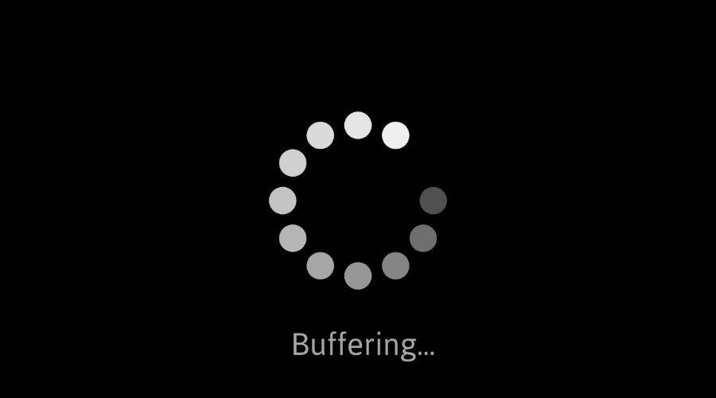
Streaming stored video: challenges
continuous playout constraint: during client video playout, playout timing must match original timing
… but network delays are variable (jitter), so will need client-side buffer to match continuous playout constraint
other challenges:
client interactivity: pause, fast-forward, rewind, jump through video
video packets may be lost, retransmitted

Slide 58
Streaming stored video: playout buffering
constant bit
rate video
transmission
client video
reception
constant bit
rate video
playout at client
Cumulative data
variable
network
delay
buffered
video
client playout
delay
time
client-side buffering and playout delay: compensate for network-added delay, delay jitter

Slide 59
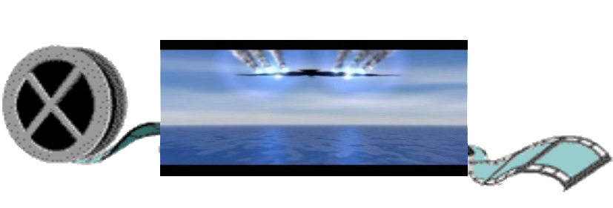
Streaming multimedia: DASH
Dynamic, Adaptive Streaming over HTTP
server:
divides video file into multiple chunks
each chunk encoded at multiple different rates
different rate encodings stored in different files
files replicated in various CDN nodes
manifest file: provides URLs for different chunks
...
...
?
...
client
client:
periodically estimates server-to-client bandwidth
consulting manifest, requests one chunk at a time
chooses maximum coding rate sustainable given current bandwidth
can choose different coding rates at different points in time (depending on available bandwidth at time), and from different servers

Slide 60

Streaming multimedia: DASH
“intelligence” at client: client determines
when to request chunk (so that buffer starvation, or overflow does not occur)
what encoding rate to request (higher quality when more bandwidth available)
...
...
?
...
client
where to request chunk (can request from URL server that is “close” to client or has high available bandwidth)
Streaming video = encoding + DASH + playout buffering

Slide 61
Content distribution networks (CDNs)
challenge: how to stream content (selected from millions of videos) to hundreds of thousands of simultaneous users?
Option 1: single, large “mega-server”
single point of failure
point of network congestion
long (and possibly congested) path to distant clients
…. this solution doesn’t scale

Slide 62
Content distribution networks (CDNs)
challenge: how to stream content (selected from millions of videos) to hundreds of thousands of simultaneous users?
Option 2: store/serve multiple copies of videos at multiple geographically distributed sites (CDN)
enter deep: push CDN servers deep into many access networks
close to users
Akamai: 240,000 servers deployed
in > 120 countries (2015)
bring home: smaller number (10’s) of larger clusters in POPs near access nets
used by Limelight

Slide 63


Example: Netflix (1)
Netflix: stores copies of content (e.g., MADMEN) at its (worldwide) OpenConnect CDN nodes
…
…
…
…
…
…
Notes:
63

Slide 64


Example: Netflix (2)
Subscriber requests content, service provider returns manifest
…
…
…
…
where’s Madmen?
…
…
Notes:
64

Slide 65
Example: Netflix (3)
Subscriber requests content, service provider returns manifest
…
…
manifest file
…
…
where’s Madmen?
…
…
Notes:
65

Slide 66
Example: Netflix (4)
Using manifest file, client retrieves content at highest supportable rate
…
…
…
…
manifest file
…
…
Notes:
66

Slide 67
Example: Netflix (5)
Client may choose different rate or copy if network is congested
…
…
…
…
manifest file
…
…
Notes:
67

Slide 68
Application layer: Learning objectives
A broad look, introducing key concepts and terminology
Principles of network applications
Web and HTTP
The Domain Name System
Video streaming and content distribution networks

Slide 69
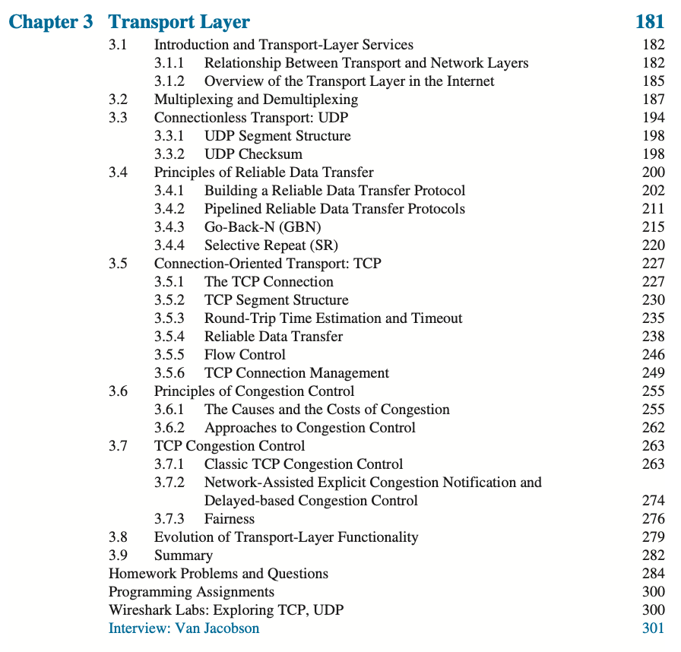

Week after Spring Break: The Transport Layer
Please read Sections 3.1-3.3, 3.5.1-3.5.2, and skim 3.8 and 3.9
Computer Networking: A Top-Down Approach . 8th edition Jim Kurose, Keith Ross Pearson, 2020

